Slide 1

CAPSTONE PROJECT
Name: D.Madhavan
Regno:192225070
Subject: CSA0656-Design Analysis and Algorithms for Asymptotic Notations.
Guided By: Dr. R. Dhanalakshmi
Professor Department Of Machine Learning
Saveetha School Of Engineering.

Slide 2
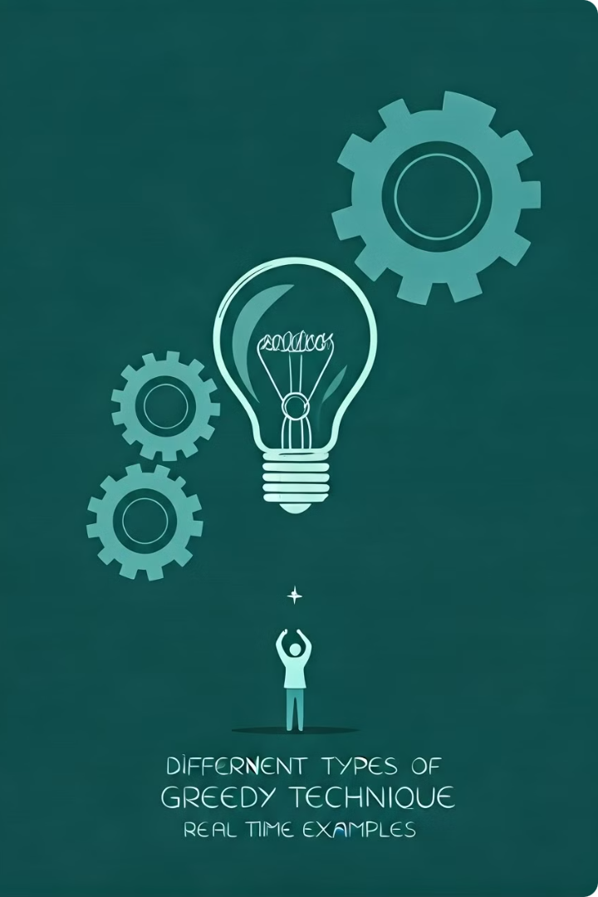
Introduction to Greedy Technique
1
Systematic Approach
2
Immediacy
It focuses on making the best decision at the current moment, without considering the long-term consequences.
The Greedy Technique follows a systematic approach, making locally optimal choices at each stage with the aim of finding a global optimum.
3
Simple Implementation
The Greedy Technique is relatively straightforward to implement, making it a popular choice for solving complex problems.

Slide 3

Problem Statement:
Maximum Number of Groups With Increasing Length You are given a 0-indexed array usage Limits of length n. Your task is to create groups using numbers from 0 to n - 1, ensuring that each number, i, is used no more than usage Limits[i] times in total across all groups. You must also satisfy the following conditions: Each group must consist of distinct numbers, meaning that no duplicate numbers are allowed within a single group. Each group (except the first one) must have a length strictly greater than the previous group. Return an integer denoting the maximum number of groups you can create while satisfying these conditions. Example 1: Input: usage Limits = [1,2,5]
Output: 3 Explanation: In this example, we can use 0 at most once, 1 at most twice, and 2 at most five times. One way of creating the maximum number of groups while satisfying the conditions is: Group 1 contains the number [2]. Group 2 contains the numbers [1,2]. Group 3 contains the numbers [0,1,2]. It can be shown that the maximum number of groups is 3. So, the output is 3..

Slide 4
Solution:
For usageLimits = [1, 2, 5]: 1. Total Usage Capacity: o total_usage=1+2+5=8\text{total_usage} = 1 + 2 + 5 = 8total_usage=1+2+5=8. 2. Compute Group Sizes: o For k = 1, S1=1S_1 = 1S1=1. o For k = 2, S2=3S_2 = 3S2=3. o For k = 3, S3=6S_3 = 6S3=6. o For k = 4, S4=10S_4 = 10S4=10. The total usage capacity of 8 is enough for groups of size up to 3 (since S4=10S_4 = 10S4=10 exceeds 8). 3. Verify Group Formation: o Verify if you can form 3 groups with sizes 1, 2, and 3, respecting the usage limits. Here, the groups can be formed as follows: ▪ Group 1: 1 element. ▪ Group 2: 2 elements. ▪ Group 3: 3 elements. This confirms that 3 groups can be formed.

Slide 5
Code:
#include <stdio.h>
struct Item {
int weight;
int value;
};
int compare(const void a, const void b) {
double ratio1 = (double)(((struct Item*)a)->value) / (((struct Item*)a)->weight);
double ratio2 = (double)(((struct Item*)b)->value) / (((struct Item*)b)->weight);
return ratio2 > ratio1;
}
double knapsackGreedy(int capacity, struct Item items[], int n) {
qsort(items, n, sizeof(items[0]), compare);
int currentWeight = 0;
double finalValue = 0.0;
for (int i = 0; i < n; i++) {
if (currentWeight + items[i].weight <= capacity) {
currentWeight += items[i].weight;
finalValue += items[i].value;
} else {
int remainingCapacity = capacity - currentWeight;
finalValue += items[i].value * ((double)remainingCapacity / items[i].weight);
break;
}
}
return finalValue;
}
int main() {
int capacity = 50;
struct Item items[] = {{10, 60}, {20, 100}, {30, 120}};
int n = sizeof(items) / sizeof(items[0]);
double max_value = knapsackGreedy(capacity, items, n);
printf("Maximum value in Knapsack = %.2f\n", max_value);
return 0;
}

Slide 6
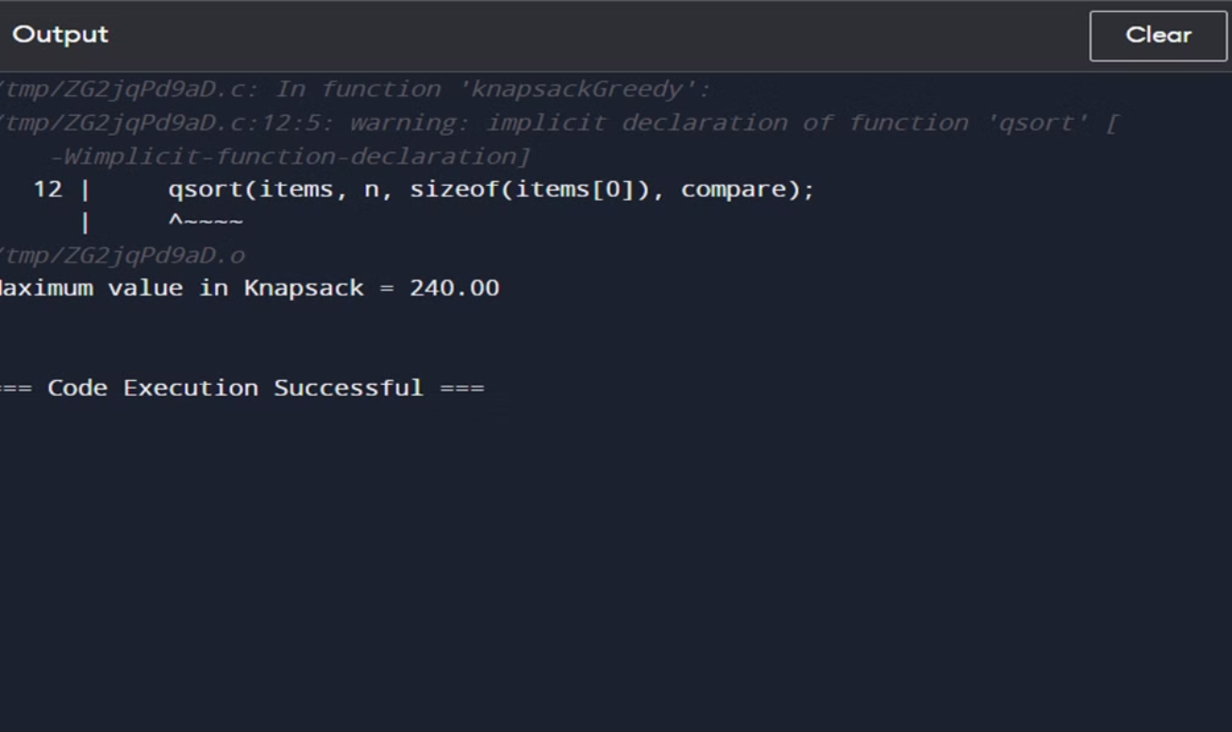
Output:

Slide 7
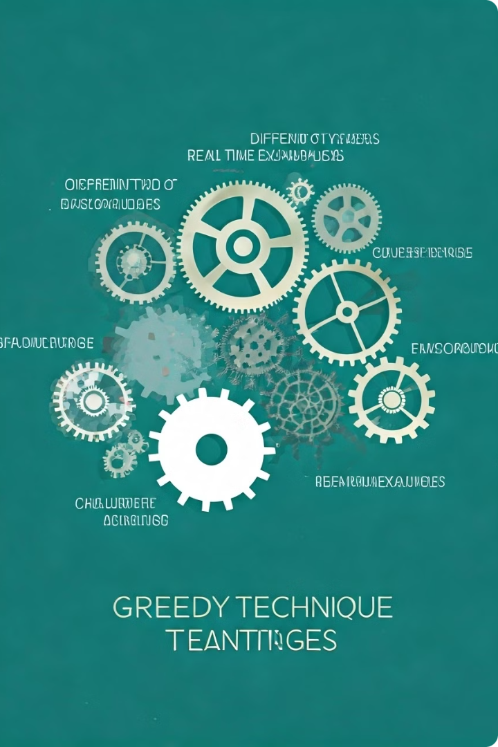
Advantages of Greedy Technique
Simplicity
Speed
The Greedy Technique is easy to understand and implement, making it a popular choice for problem-solving.
It can quickly find a solution, as it does not require extensive analysis or backtracking.
Memory Efficiency
Applicability
The Greedy Technique does not require storing a large amount of data, making it memory-efficient.
It can be applied to a wide range of problems, from scheduling to optimization tasks.

Slide 8
Disadvantages of Greedy Technique
No Guarantee of Optimality
Lack of Flexibility
Potential for Suboptimal Solutions
It cannot backtrack or reconsider previous decisions, limiting its ability to adapt to changing situations.
The Greedy Technique does not always find the globally optimal solution, as it focuses on local optimality.
In some cases, the Greedy Technique may lead to suboptimal solutions that are not the best overall.

Slide 9





Applications of Greedy Technique
Scheduling
Network Optimization
Resource Allocation
Graph Algorithms
Allocating resources and tasks based on immediate needs.
Traversing and exploring graphs using the Greedy Technique.
Improving network efficiency by prioritizing the most critical connections.
Distributing limited resources to maximize immediate benefits.

Slide 10

Greedy Technique Algorithms
1
Kruskal's Algorithm
Finds the minimum spanning tree of a weighted graph by adding the cheapest available edge at each step.
2
Dijkstra's Algorithm
Computes the shortest path between nodes in a graph by repeatedly choosing the node with the smallest distance.
3
Huffman Coding
Constructs an optimal prefix code by repeatedly combining the two least frequent symbols into a new node.

Slide 11

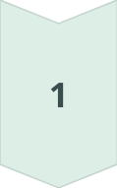
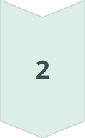
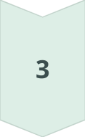
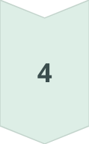
Implementing Greedy Technique in Projects
Problem Analysis
Identify the problem and its characteristics to determine if the Greedy Technique is an appropriate approach.
Algorithm Selection
Choose the right Greedy Technique algorithm based on the problem requirements and constraints.
Implementation
Carefully implement the selected algorithm, ensuring it meets the project's objectives.
Testing and Optimization
Thoroughly test the implementation and optimize it for efficiency, if necessary.

Slide 12

Conclusion and Key Takeaways
1
Powerful Approach
2
Balancing Advantages and Disadvantages
The Greedy Technique is a powerful problem-solving approach that can be applied to a wide range of problems.
Understanding the strengths and limitations of the Greedy Technique is crucial for effective implementation.
3
Continuous Learning
Staying up-to-date with the latest Greedy Technique algorithms and their applications is essential for staying competitive.

